Slide 1
What We Need to Teach Students About Effective Study Skills (and Why They Won’t Believe Us)
Stephen L. Chew, PhD
Department of Psychology
Samford University
slchew@samford.edu Twitter: @SChewPsych
Tennessee Association for Student Success and Retention (TASSR)
October 3, 2019

Slide 2
Goals for this Presentation
Discuss cognitive principles of learning students and teachers need to understand to succeed academically
Speculate on why students ignore or resist these principles
Speculate on some possible ways forward

Slide 3
Student Struggle in College
Only about 25% of entering college students are considered college ready in all subjects
Overall 59% six-year college completion rate
Lower rates for minorities, first generation college students, and students taking multiple remedial courses

Slide 4
Student Beliefs about How People Learn
Students base their study behavior based on their models of how people (specifically themselves) learn.
It determines their learning effectiveness, achievement, and success
Most students base their learning strategies on untested assumptions, faulty intuitions, and misconceptions
Notes:
Whether or not they go to class,
If and how well complete assignments,
How they study and when material is mastered

Slide 5
Differences in Learning Context from High School to College
Only about 1/3 the contact hours with teachers
Less scaffolding; much more independent learning
Fewer learning activities in and outside of class
Demand for a deeper level of understanding
Fewer feedback opportunities
Fewer assessments for higher stakes
Less peer social support
Teachers both less well trained and less likely to prioritize learning
A culture of completion to a culture of access
Notes:
Learning strategies that worked in high school don’t work in college

Slide 6
Helping students be successful in college
Many developmental and tutoring programs are content focused
Teach them how to be more effective learners
correct misconceptions
Model cognitive principles of learning in our teaching
Teach them how to apply cognitive principles of learning
Notes:
Both Students and Teachers often base their actions on untested assumptions, informal intuition, and faulty beliefs about how people learn These misconceptions undermine student learning
Talk about common misconceptions of teachers and students
Not just about content like remediation

Slide 7
Stumbling Blocks in Learning
Common Misconceptions about learning
Attention
Metacognition
Learning Strategies

Slide 8
Beliefs about Learning that Make You Stupid
Learning is fast
Being good at a subject is a matter of inborn talent rather than hard work
Knowledge is composed of isolated facts
I’m really good at multi-tasking, especially during class or studying
Notes:
Typical beliefs or comments: “One good reading is enough” or “I read 8 chapters last night”
You learn more during review than you do at initial reading
Students, especially weak students, grossly underestimate the time required to complete assignments
As a result, they start studying or working on assignments too late
I do it all the time, so I must be good at it
Study while monitoring texts, checking facebook, watching videos, carrying on conversations
Any distraction takes away from our ability to concentrate and learn
Virtually no one is good at multitasking
Typical beliefs and comments:
“I’m bad at math.”
“Maybe this time I’ll get lucky”
Belief in fixed intelligence, vs. malleable intelligence
Often reinforced by feedback, “You are smart” or “Science is just not your thing”
Study by memorizing facts in isolation of each other
Highlighting bolded terms in the text, then studying those

Slide 9
ACT by First Year GPA

Slide 10
Beliefs about Learning that Make You Stupid
Learning is fast
Being good at a subject is a matter of inborn talent rather than hard work
Knowledge is composed of isolated facts
I’m really good at multi-tasking, especially during class or studying
Notes:
Typical beliefs or comments: “One good reading is enough” or “I read 8 chapters last night”
You learn more during review than you do at initial reading
Students, especially weak students, grossly underestimate the time required to complete assignments
As a result, they start studying or working on assignments too late
I do it all the time, so I must be good at it
Study while monitoring texts, checking facebook, watching videos, carrying on conversations
Any distraction takes away from our ability to concentrate and learn
Virtually no one is good at multitasking
Typical beliefs and comments:
“I’m bad at math.”
“Maybe this time I’ll get lucky”
Belief in fixed intelligence, vs. malleable intelligence
Often reinforced by feedback, “You are smart” or “Science is just not your thing”
Study by memorizing facts in isolation of each other
Highlighting bolded terms in the text, then studying those

Slide 11
Stumbling Blocks in Learning
Common Misconceptions about learning
Attention
Metacognition
Learning Strategies

Slide 12
The Nature of Attention
Attention is like a small spotlight in a darkened room.
Narrow focus
Anything that draws attention away from the critical feature hurts attention

Slide 13
Learning Loss Due to Distractions (Blasiman, et al., 2018)
Notes:
Online courses

Slide 14
Inattentional Blindness
We miss most anything outside our focus of attention, and we are unaware that we missed anything

Slide 15
Inattentional Blindness

Slide 16
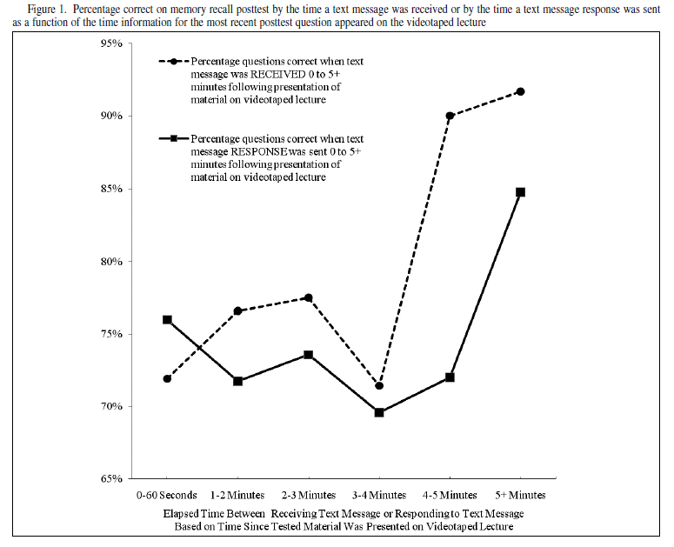
Attentional Blink
Notes:
Rosen

Slide 17
The Cost of Multitasking
Partner up; you will need a stopwatch
Time each other doing the following:
As quick as you can, count down from 10 to 0, then immediately say the alphabet out loud from A-K
Now, alternate between the alphabet and counting down, 10-A, 9-B,…
Divide your second task time by your first task time

Slide 18
The Arithmetic of Distracted Studying
Assuming Distracted Study takes three times longer than
Focused Study to achieve the same level of learning
Focused Study
Takes 30 Minutes
Distracted Study
Takes 90 minutes
Focused Study gives you
60 Minutes (undistracted) free time
30
Minutes
Turns into
90 Minutes
30 Minutes
of Study
Which could
be
60 Minutes
Of Free Time

Slide 19
The Cost of Distractions
Friends
Vimeo
iTunes
Noise
Video games
Tumblr
Television
Texts
Facebook
Snapchat
Hunger
Email
Reddit
Amazon
Alerts
Skype
Phone calls
Pandora
Parties
Hulu
Twitter
Netflix
Spotify
Sports
Parents
YouTube
Pinterest
Instagram

Slide 20
The Importance of Undivided Attention
There is NO evidence that multi-tasking is as effective as concentrating on one task at a time
Good study strategies are effortful, and require full concentration
Even small distractions can significantly reduce learning
Resisting temptation is a distraction
For best concentration, remove temptations
Apps for blocking distractions (RescueTime; Freedom)

Slide 21
Stumbling Blocks in Learning
Common Misconceptions about learning
Attention
Metacognition
Learning Strategies

Slide 22
Metacognition
A student’s awareness of their level of understanding of a topic
Metacognition distinguishes between stronger and weaker students
One of the major tasks for a freshman is developing good metacognition
In high school, you spent years developing a metacognitive sense that is likely inadequate or even counterproductive for college.

Slide 23
Self-Rating
What is your best, most accurate judgment of the percentage of questions that you answered correctly on this exam? Your answer may range from 0 to 100%
_____________________% correct

Slide 24
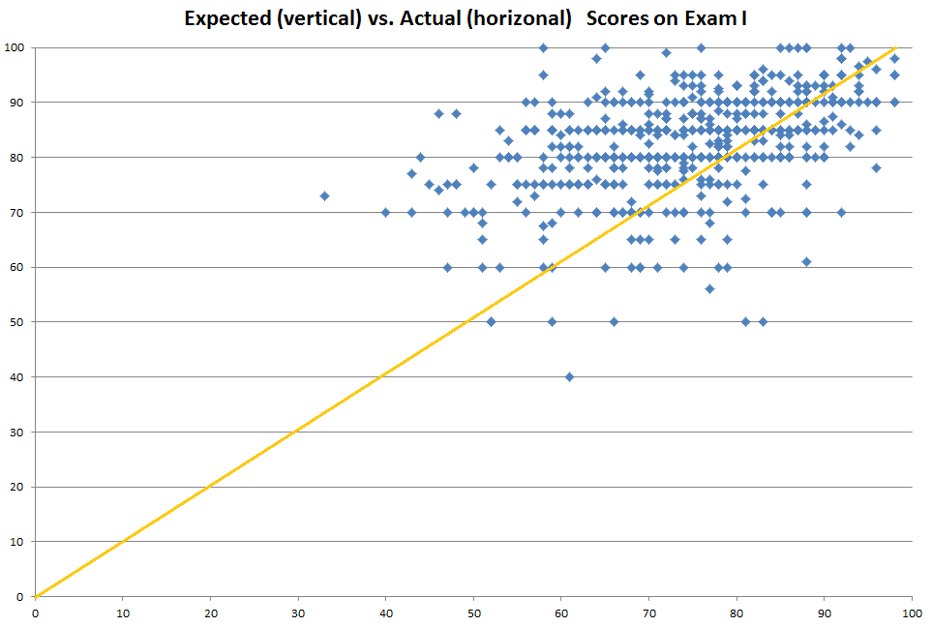
Estimated and Actual Grades for 800 Students: Econ 101

Slide 25
Poor Metacognition
From one of my students:
I don't understand why I am doing poorly on the exams. I prepared well for this exam and felt like I knew the material and did well on the exam but I obviously did not.
Notes:
Good scores is not a matter of luck.

Slide 26
The irony of poor metacognition
Students who have the poorest metacognition have no clue how weak their understanding of a concept is.
Part of being incompetent is not understanding just how incompetent you are.
So the students who most need to listen closely to this talk, are the ones who don’t believe they need to.

Slide 27
Stumbling Blocks in Learning
Common Misconceptions about learning
Attention
Metacognition
Learning Strategies

Slide 28
Student Misconception about Study Skills
Students assume all studying is equally effective, only amount matters
Do what is easy and fast, but effective study is slow and effortful

Slide 29
About Learning Strategies
Good intentions cannot overcome bad study strategies
Both time and quality of study matters
Deep level of processing is critical for learning
Freshmen have highly practiced poor learning strategies

Slide 30
Achieving Deep Processing while Studying
As you study, follow these principles:
Elaboration: How does this concept relate to other concepts? Can I make a story?
Distinctiveness: How is this concept different from other concepts?
Personal: How can I relate this information to my personal experience?
Appropriate to Retrieval and Application: How am I expected to use or apply this concept?
Notes:
Elaboration: They are both ways of rehearsing information
Distinctiveness: shallow processing is easy and fast, but does not lead to long-term learning. Deep processing is effortful and slow but does lead to long-term learning
Personal: I like to work through examples for deep processing
Application: I practice recalling information without checking the book

Slide 31
Forgetting, then Relearning, is Highly Effective for Long-term Recall
Study with comprehension and understanding
Forget, preferably by studying another topic
Review with comprehension and understanding
Forget, preferably by studying another topic
Review with comprehension and understanding
Sample Strategies:
Spaced practice
Interleaving
Self-testing

Slide 32
Nuthall’s “Rule of Three”
For long-term learning to occur:
A student needed to encounter, on at least three different occasions, the complete set of information she or he needed to understand a concept. Nuthall (2007, p. 63)
Students must possess all the information needed to understand a concept.
The information must be encountered on at least three different occasions.
The information must be fully interpreted and integrated into working memory on each occasion.

Slide 33
Why students resist changing ineffective learning practices

Slide 34
Study Strategies are Hard to Change
Misconceptions about learning are tenacious
Many students have highly practiced poor learning strategies
Bad study strategies are seductive and easier to do than effective ones
Shifting metacognitive awareness is difficult
Technology makes it easy to study badly

Slide 35
Bad Study Strategies are Seductive
Bad study strategies increase confidence without increasing actual learning
Students are poor judges of their own learning
Students confuse familiarity and amount of study with learning
Students confuse availability with learning

Slide 36
Most people are poor judges of their own learning
Generation
Interleaving Skills
Spacing
Predicted
Predicted
Satisfaction
Rating of Training
Actual
Actual
Actual
Pre-testing
Interleaving Concepts
Stability Bias
Judged
Judged
Predicted
Actual
Actual
Actual

Slide 37
Familiarity vs. Learning
Students confuse familiarity with learning

Slide 38
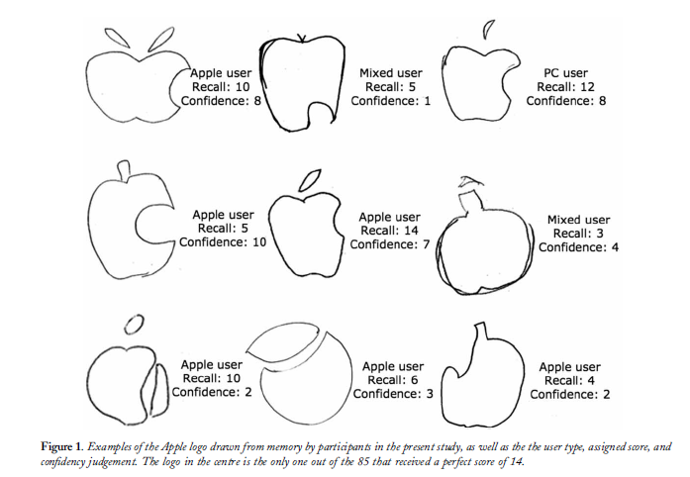
Knowing the Apple Logo Blake, Nazarian, & Castel, (2015)
When asked to pick correct logo out of 12 options, 53% failed
When asked to draw it, only 1 of 85 could do so.

Slide 39
Familiarity vs. Learning
Students confuse familiarity with learning

Slide 40
Availability of Information
Google Effect
Only half of online students take notes on lectures (Morehead, et al. (2019)
Technology makes it easy to study badly

Slide 41
Looking for Quick, Easy Fixes
Seeing success as a function of finding the right shortcut vs one’s own effort
Looking for the right “hack” for a course, teacher, or test
Assuming successful students have figured it out or get special treatment
“You get a better grade on English papers if you use big words”
“If you take the right prep course, you can get a 34 on the ACT”
“I tried it your way and it didn’t work”

Slide 42
So, what can we do…
Anticipate poor study habits and train students to use better ones
Help them plan out better study habits

Slide 43
The Question Every Student Should Answer When Studying
What evidence do I have that I understand this material?
Hope is a lousy test taking strategy
Amount of time and effort is a poor proxy for learning
Use of validated study strategies is better, but not necessarily enough
Honest Self-assessment using questions similar to what the teacher expects is best

Slide 44
Video Series: How to Get the Most Out of Studying http://www.samford.edu/how-to-study/

Slide 45
Anticipating Poor Metacognitive Awareness

Slide 46
Anticipating Poor Exam Preparation

Slide 47
Phases of Self-Regulated Learning (Pintrich)
Forethought and Planning: Students analyze the learning task and set specific goals
Performance Monitoring: Students employ strategies to make progress on the learning task and monitor the effectiveness of those strategies as well as their motivation for continuing toward goals
Reflection on Performance: Students evaluate their performance on the learning task with respect to the effectiveness of the strategies that they chose.
Notes:
When students learn unfamiliar topics, however, they may not know the best ways to approach the task or what goals might be the most appropriate.

Slide 48
Self-Regulation Cycle (Pintrich)
Performance Monitoring Phase
Employ strategies to make progress on the learning task.
Monitor the effectiveness of the strategies employed.
Monitor motivation for completing the learning task.
Reflection on Performance Phase
Evaluate performance on the learning task.
Manage emotional responses related to the outcomes of the learning experience.
Forethought and Planning Phase
Analyze the learning task.
Set goals toward completing the task.

Slide 49
Take Home Message
Most students have highly practiced, poor study habits
Student intuitions and beliefs about learning are faulty
Many obstacles to becoming an effective learner
We must to help students overcome these obstacles, not just in our classes, but across the curriculum

Slide 50
Thank You! Questions?
Stephen L. Chew
slchew@samford.edu

