Slide 1
Intelligent Practice Formula
College Success
First Year Experience

Slide 2
Intelligent Practice formula
Effort
+
Good Strategies
+
Help from Others

Slide 3
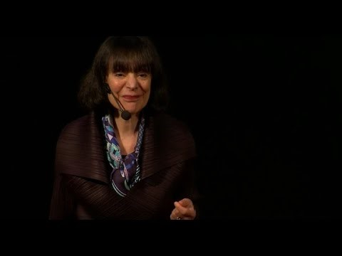
Growth mindset Research of Carol dweck

Slide 4
First Three Class Meetings

Slide 5
Effort
Michael Jordan

Slide 6
Good Strategies
Number Sequencing Activity

Slide 7
Help from others
Introduce College Resources

Slide 8
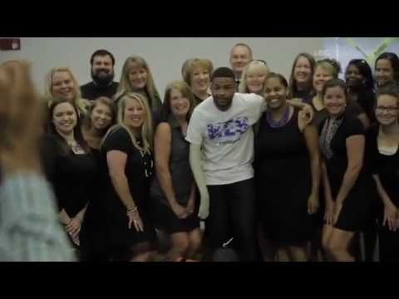
How Does Inky Johnson Use The Intelligent Practice Formula?

Slide 9
Other Topics for 1st five weeks
Science behind growth mindset
Neural Pathways
Neural Plasticity
Grit
Angela Duckworth
Metacognition
Reflection
Communicating with professors
Study Skills

Slide 10
Remaining Weeks
Reading Strategies
Career Research
Academic Plan
Campus Resources
Hero’s Journey

Slide 11
Lora Bagwell
llbagwell@pstcc.edu

