Slide 1
Song Lyrics Activity
Katie Gruber, M.A.
Lecturer
Middle Tennessee State University

Slide 2
Inspiration & Overview
Rationale
Music-centered school
Relatable
Getting out of the “box”

Slide 3
Activity
Preparation
Assignment Deliverables
Day-Of Activity

Slide 4
Preparation
Imagery
Simile
Metaphor
Rhythm
Alliteration
Repetition
Parallelism
Antithesis

Slide 5
Their Homework
Find a song & print the lyrics

Slide 6
Day Of
NOT singing!
Present part of song
Instructor example!

Slide 7
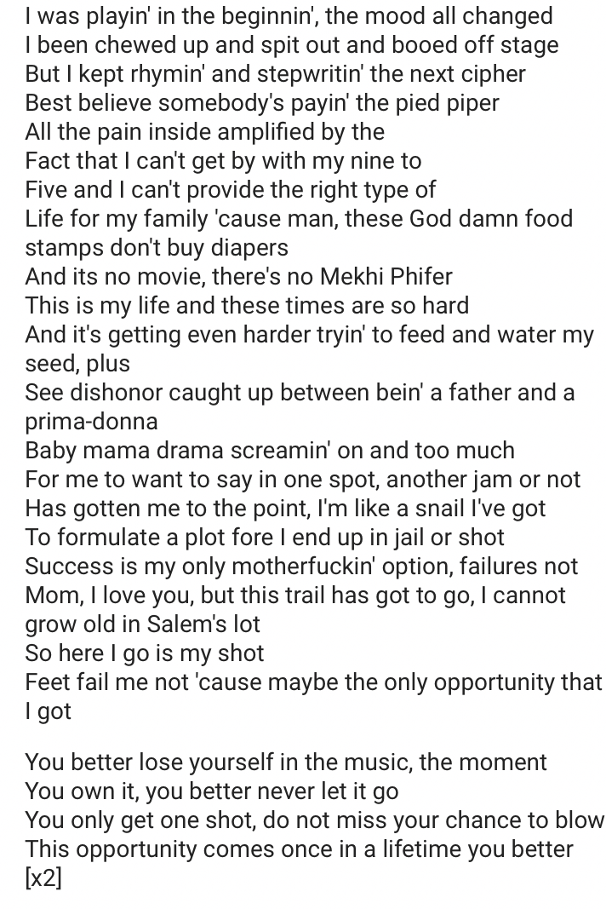
Instructor Example!
Songwriters:
Jeffrey Irwin Bass
Luis Edgardo Resto
Marshall B. Mathers

Slide 9
Debriefing/Discussion
Song examples
Artist choice

Slide 10
Simile
“You change your mind like a girl changes clothes.”
-- Perry, Dr. Luke, & Max Martin
“She’s got me twisted like an old beach roller coaster.”
-- Michael Carter & Cole Swindell

Slide 11
Metaphor
“On this broken merry-go-'round And 'round and 'round we go, Where it stops, nobody knows”
-- Kacey Musgraves, Josh Osborne, Shane McAnally

Slide 12
Appraisal
My observations
Survey of 58 students, Spring 2017

Slide 13
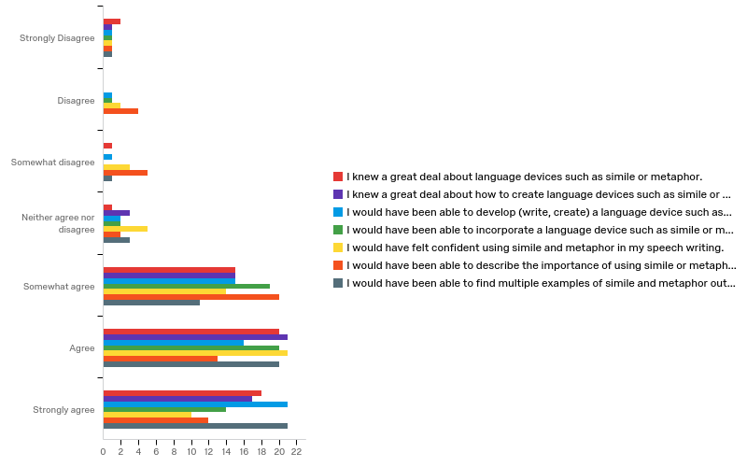
Q2 - First, I would like to ask you a few questions about your perceptions BEFORE you read Chapter 12 or listened to the lecture on Chapter 12 in class. Prior to reading Chapter 12 or listening to the class lecture:

Slide 14
Q2 - First, I would like to ask you a few questions about your perceptions BEFORE you read Chapter 12 or listened to the lecture on Chapter 12 in class. Prior to reading Chapter 12 or listening to the class lecture:
Answer | %
I knew a great deal about language devices… | 65.5%
I knew a great deal about how to create language devices… | 65.5%
I would have been able to develop a language device… | 63.7%
I would have been able to incorporate a language device… | 58.6%
I would have felt confident using simile and metaphor… | 53.4%
I would have been able to describe the importance of… | 43.1%
I would have been able to find multiple examples of… | 70.6%

Slide 16
Q3 - Now, I would like to ask you a few questions about your perceptions AFTER you completed this song lyrics class activity. After completing this activity in class:
Answer | %
I now know a great deal about language devices… | 77.5%
I now know a great deal about how to create language devices… | 70.6%
I am now able to develop a language device… | 70.6%
I am now able to incorporate a language device… | 72.4%
I now feel confident using simile and metaphor… | 70.6%
I am now able to describe the importance of… | 63.7%
I am now able to find multiple examples of… | 82.7%

Slide 17
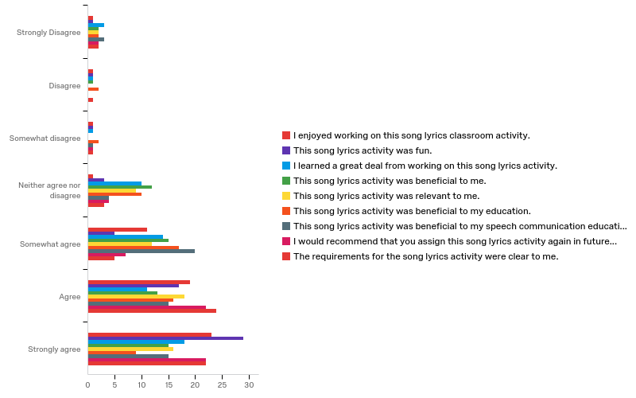
Q4 - Now, I would like to ask you to give me your overall evaluations of this song lyrics activity.

Slide 18
Q4 - Now, I would like to ask you to give me your overall evaluations of this song lyrics activity.
Answer | %
I enjoyed working on this activity. | 72.4%
This song lyrics activity was fun. | 79.3%
I learned a great deal from working on this activity. | 50%
This activity was beneficial to me. | 48.3%
This activity was relevant to me. | 58.6%
This activity was beneficial to my education. | 43%
This activity was beneficial to my speech education. | 51.7%
I would recommend assigning this activity again. | 75.8%
The requirements for this activity were clear to me. | 79.3%

Slide 19
Q5 - What word(s) would you use to describe this song lyrics activity? You can enter more than one word.
Answer | % | Count
“Fun” | 34% | 20
“Entertaining” or “Enjoyable” | 19% | 11
“Different” or “Creative” | 19% | 11
“Educational” or “Helpful” | 7% | 4
Total | 79% | 46

Slide 20
Q7 - Have you previously taken the General Education course ENGL 1010?
Answer | % | Count
Yes | 84% | 49
No | 9% | 5
Currently enrolled | 7% | 4
Yes, did not pass | 0% | 0
Total | 100% | 58

Slide 21
Demographics
Classification | %
Freshman | 67%
Sophomore | 26%
Junior | 7%
Senior | 0%
Sex | %
Male | 45%
Female | 55%
Age
Range | 18 – 33
Mean | 23
Median | 19
Mode | 19

Slide 22
Takeaways
While only 50% said they “learned a great deal” and only 43% said it was “beneficial to their education,” nearly 80% said it was “fun” and 75% would recommend the activity.

Slide 23
How to Incorporate in YOUR CLASS
Variations of activity
Speech class
Variations of activity
English classes
Music classes
History classes
Others??

Slide 24
Thank you!

