Slide 1
Advising Truths with Student Success
What We Know For Sure
Sonja R Burk, M.Ed. Karen Austin, M.A.
Middle Tennessee State University College of Liberal Arts Advisors

Slide 2
College of Liberal Arts Careers
What can I do with this major?
Would you like fries with that?

Slide 3
Let’s talk about…..
Career Advising vs. Academic Advising
Successes we’ve had at MTSU
Case Study Example

Slide 4
Academic Advising IS Career Advising
Career advising is a large part of our advising success
It starts in the advisor’s office
This is substantiated by the National Association of Colleges and Employers ‘16-17 report.

Slide 5
Why is this Important?
The largest groups of students coming out of high school in the coming decade will be Hispanics, low-income, and those who are the first in their family to go to college

Slide 6
MTSU’s 2017 Student Population
66% of Student Population is College Ready (ACT composite 21+)
Approximately 20,000 undergraduates (11% in College of Liberal Arts)
~50% Pell eligible
~50% First Generation

Slide 7
This I believe… (no really – What works for us)
Advising Truths…
You cannot successfully advise someone you do not know
You cannot successfully advise someone who does not trust you
You can successfully advise someone when you are engaged in the conversation
You can successfully advise someone when you are aware of their career goals

Slide 8
Hi, Are you busy? I have a quick question.

Slide 9
Establishing the Student Relationship
Holistic & Appreciative Advising – Setting the Tone
Welcoming and friendly office
Water and healthy snacks
Positive and inspirational quotes in office
Appointment times: 30, 45, and 60 minutes

Slide 10
Advising Truths with Student Success Establishing a Student Relationship
Holistic & Appreciative Advising – Establishing Trust
Inquire about current classes, professors, organizations, etc.
Open-ended questions
Sum-up/Close the meeting with Action Items for both of you
Follow through on your Action Items
Notes:
2 minutes of small talk opens doors to new subjects
Why did you choose Sociology? What will impact your schedule or availability?

Slide 11
Career Questions

Slide 12
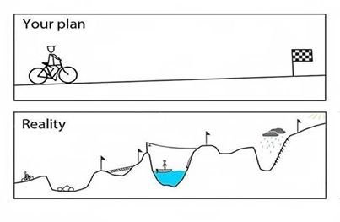
Advising Truths with Student Success
A student’s career journey needs to start in the advisor’s office

Slide 13
Facilitators
Sonja Burk, M.Ed., MTSU College of Liberal Arts Advisor
Karen Austin, M.A., MTSU College of Liberal Arts Advisor

