Slide 1
Gateway course success
Scaling Corequisite

Slide 2
Too many students start college in remediation.

Slide 3
Too many entering freshmen need remediation.
51.7%
of those entering a 2-year college enrolled in remediation
19.9%
of those entering a 4-year college enrolled in remediation
Source: Fall 2006 cohorts

Slide 4
Too few remedial students ever graduate.

Slide 5
Most remedial students never graduate.
Source: Completion data: fall 2006 cohorts; graduation data: 2-year, fall 2004 cohorts; 4-year, fall 2002 cohorts

Slide 6
Student attrition is at the heart of the matter.

Slide 11
Few Ever Get to Gateway
70% of students placed into remediation fail to enroll in a gateway course in two academic years

Slide 12
Policy Objectives for Gateway Course Success
Math pathways shall be aligned with programs
Gateway courses shall be the default placement for most students
Students requiring academic support shall receive it as a corequisite.
Placement shall match students to the appropriate level of corequisite support
Utilize student success metrics to set performance benchmarks and create financial incentives to increase completion of gateway courses within one academic year

Slide 13
Academy 2.0
Academy 2.0 supports
the statewide scaling of reforms
in CCA’s leading states

Slide 14
You are a Leader!
COMMITTED to transforming remediation
ESTABLISHED legislation and state policies guiding and allowing necessary reforms
INVESTED considerable time and resources to the development of a strategy
IMPLEMENTING successful models
in your states

Slide 15
The Blueprint
When fully implemented at scale…
your reforms
will be the blueprint
for how all states can dramatically
increase the number of students
passing gateway courses.

Slide 16
Complete College America’s Goal
4-5 States will scale
corequiste support
this year.

Slide 17
What is Statewide Scale?
A state system where . . .
the vast majority of students . . .
at the vast majority of institutions . . .
receive academic support as a corequisite . . .
. . . resulting in dramatic increases in the number of students completing gateway math and English courses in one academic year.

Slide 18
Guiding Objective
Students complete gateway courses and enter programs of study in one academic year

Slide 19
Mathematics
must be aligned
with programs of study.

Slide 20
University System of Georgia Mathematics Task Force:
“College Algebra was designed explicitly to meet the needs of students who are preparing to take Precalculus and Calculus.”

Slide 21
College Algebra’s Only Purpose : Preparation for Calculus
College Algebra
Calculus
STEM

Slide 22
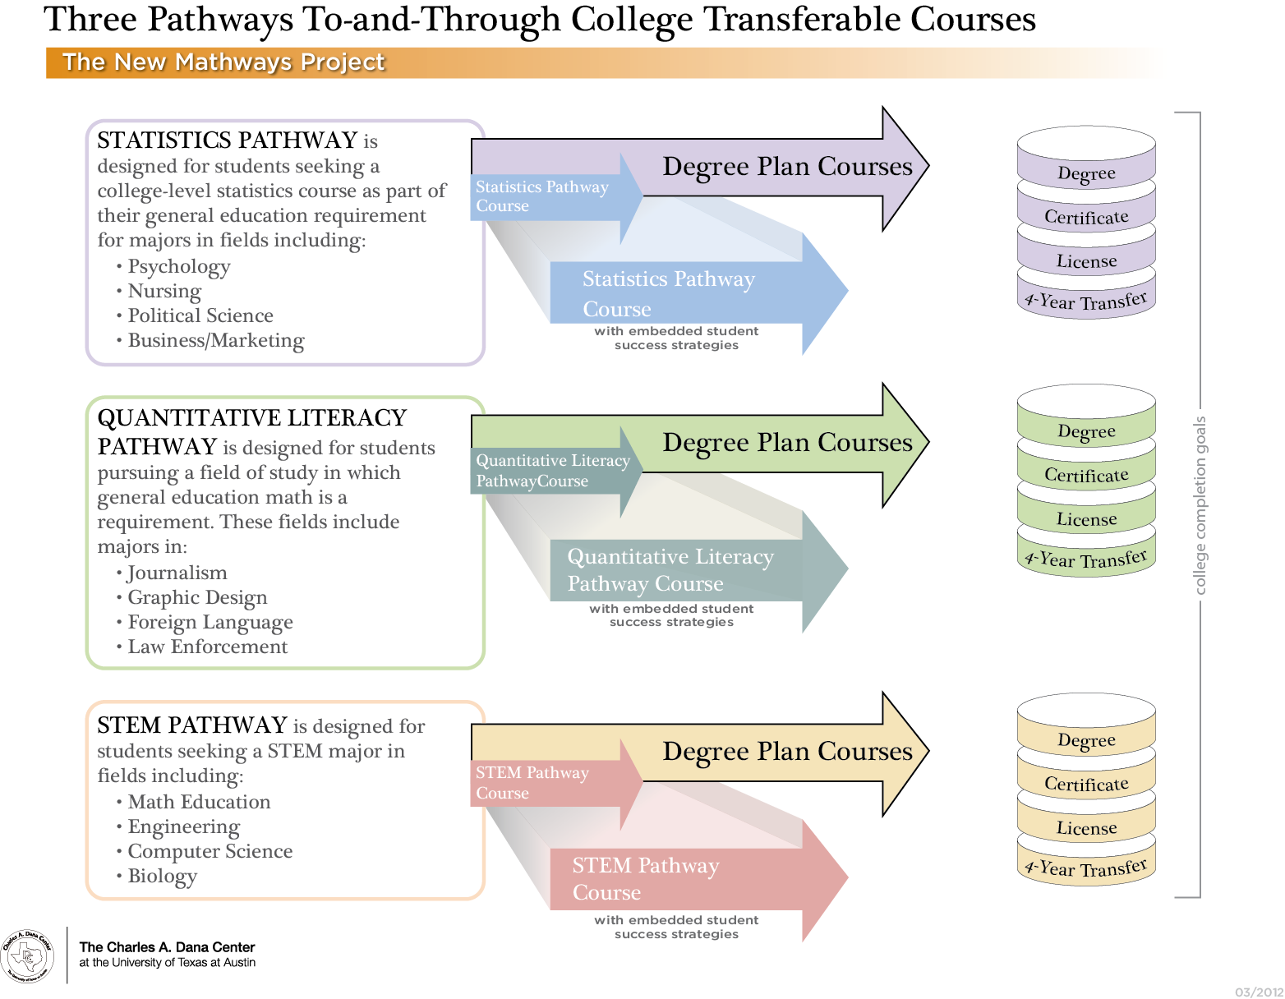
STEM

Slide 23
Math Pathways Panel
Jenna Cullinane, Charles A. Dana Center, University of Texas – Austin
Nicole Gray, Carnegie Foundation for the Advancement of Teaching
Malcolm Adams, University of Georgia
Tristan Denley, Tennessee Board of Regents

Slide 24
Providing Academic Support as a Corequisite

Slide 25
One Semester Redesigned Gateway
Extra Time
45 minutes after class
Mandatory Tutoring
Paired proctored labs
Sequenced
5 weeks prep plus 10 weeks gateway content
Additional class periods
Gateway

Slide 26
One Semester Corequisite Results
Institution | Subject | Traditional Model | Corequisite Model
CC of Baltimore County Accelerated Learning Model | English | 33% | 74%
Austin Peay State University Structured Assistance | English | 49% | 70%
 | Quantitative Reasoning | 11% | 78%
 | Statistics | 8% | 65%

Slide 27
One Year Corequisite
Semester 1
Semester 2
Quantitative Reasoning
Gateway Content
Academic Support
College Success Skills
Gateway
Statistics
STEM

Slide 28
One Year Corequisite Results
Carnegie Statway
Success in gateway math within one academic year
Traditional Model: 5.9%
Statway: 51%

Slide 29
Aligned and Parallel Support in Technical Certificate Programs
Technical Program
Math and Language Skills
Tennessee Colleges of Applied Technology
Work Keys/Keytrain
Required, Proctored Lab
Competency-based, Self-paced

Slide 30
TCAT Results
79% Graduation Rate
All Complete Academic Support

Slide 31
Corequisite Panel
Carol Puryear, Tennessee College of Applied Technology
Peter Adams, Accelerated Learning Program
Loretta Griffy, Austin Peay State University

Slide 32
Placement into gateway courses and programs of study

Slide 33
Goal of Assessment Reform : More Students in Gateway Courses
DON’T:
Try to build the perfect test
Create a new system for sorting students into the same system of long remedial sequences
DO:
Use assessment results to inform student choice and guide students into programs of study
Develop tools to match students in the right courses with the right supports

Slide 34
Plotting a Path to Programs of Study
High school Performance
(GPA/Senior Year Courses)
Placement/Entrance Exams
“Grit” questionnaire
Career/Academic Program Goal

Slide 35
Current Model Enrolls Most Students into Remediation
Remediation
Gateway
Percent of Students
70%
30%
Student Data

Slide 36
New Model Enrolls Most in College
Test Prep or Technical Certificate
Gateway Course with Corequisite Support
Gateway
Percent of Students
10%
60%
30%
Student Data

Slide 37
Low Stakes – High Reward for Students
Less than 2.0 HS GPA or
ACT Below 14 or Equivalent
2.0 – 2.5 High School GPA or ACT 14-18 or Equivalent
2.5 High School GPA or ACT 19 or Equivalent
Percent of Students
10%
60%
30%
Student Data

Slide 38
Placement Panel
Peter Adams, Accelerated Learning Project
Tristan Denley, Tennessee Board of Regents

Slide 39
Scaling through
state legislation
and policy

Slide 40
Policy Panel
Casey Sacks, Colorado Community College System
Paula Myrick Short, University of Houston System

Slide 41
Policy Objectives for Gateway Course Success
Math pathways shall be aligned with programs
Gateway courses shall be the default placement for most students
Students requiring academic support shall receive it as a corequisite.
Placement shall match students to the appropriate level of corequisite support
Utilize student success metrics to set performance benchmarks and create financial incentives to increase completion of gateway courses within one academic year

